Slide 1
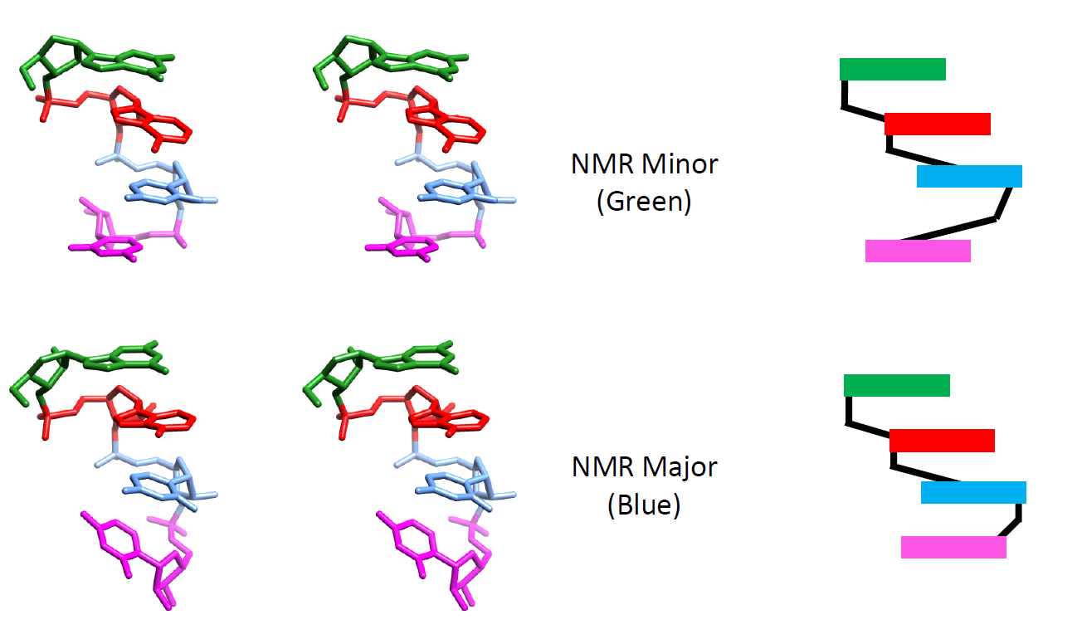
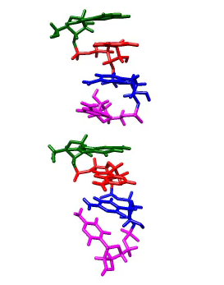
…a system where we can get complete sampling
r(GACC) tetranucleotide
[Turner / Yildirim]
NMR suggests two dominant conformations…
…compare to MD simulations in explicit solvent

Slide 2
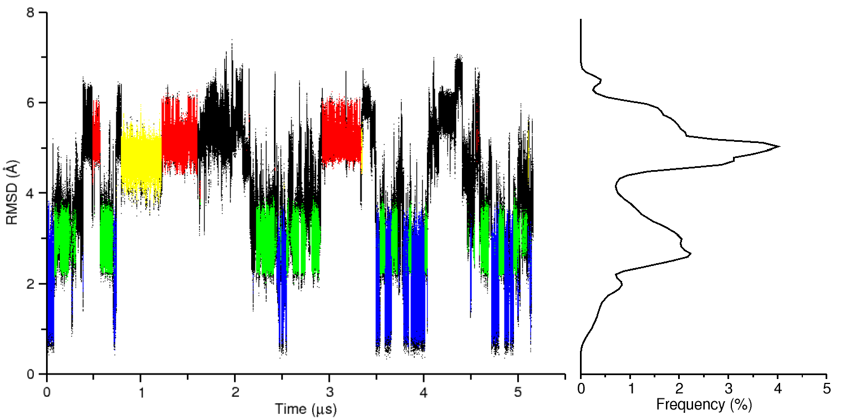
r(GACC) tetranucleotide: AMBER ff12
< explicit solvent time-contiguous straight MD simulation >

Slide 3
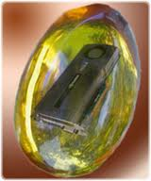
Blue Waters PRAC: The main goals are to hierarchically and tightly couple a series of optimized molecular dynamics engines to fully map out the conformational, energetic and chemical landscape of RNA.
independent ||
MD engines
…
exchanging information
(e.g. T, force field, pH, …)
…
Current players: Cheatham, Roitberg, Simmerling, York, Case

Slide 4
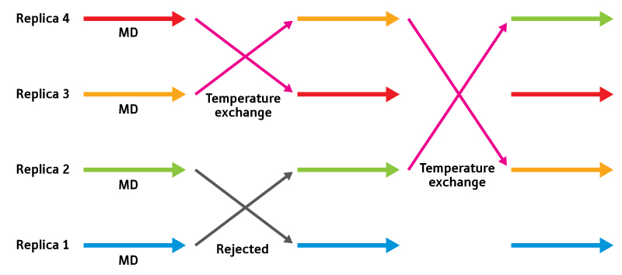
REMD = replica exchange molecular dynamics
400 K 366 K 333 K
366 K 400 K 400 K
333 K 333 K 366 K
300 K 300 K 300 K
( replica trajectories span all temperatures; to understand
the properties at a particular temperature, we need to sort the replica trajectories; this is automated in cpptraj )
www.rikenresearch.riken.jp

Slide 5
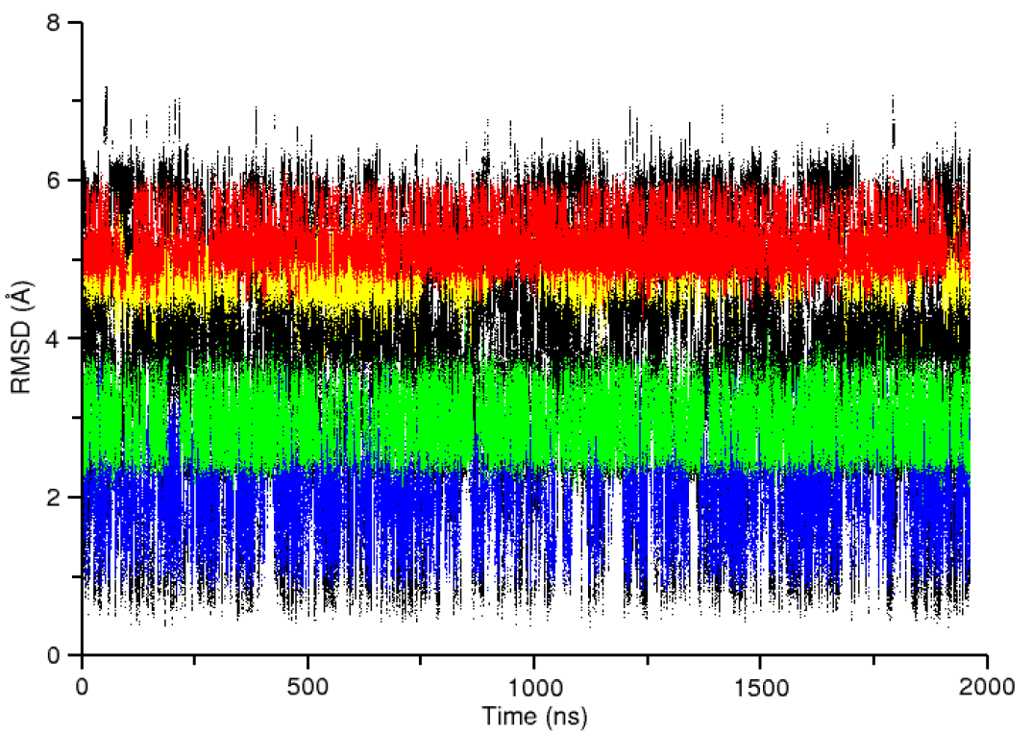
Standard MD
r(GACC) tetranucleotide
Replica-exchange MD

Slide 6
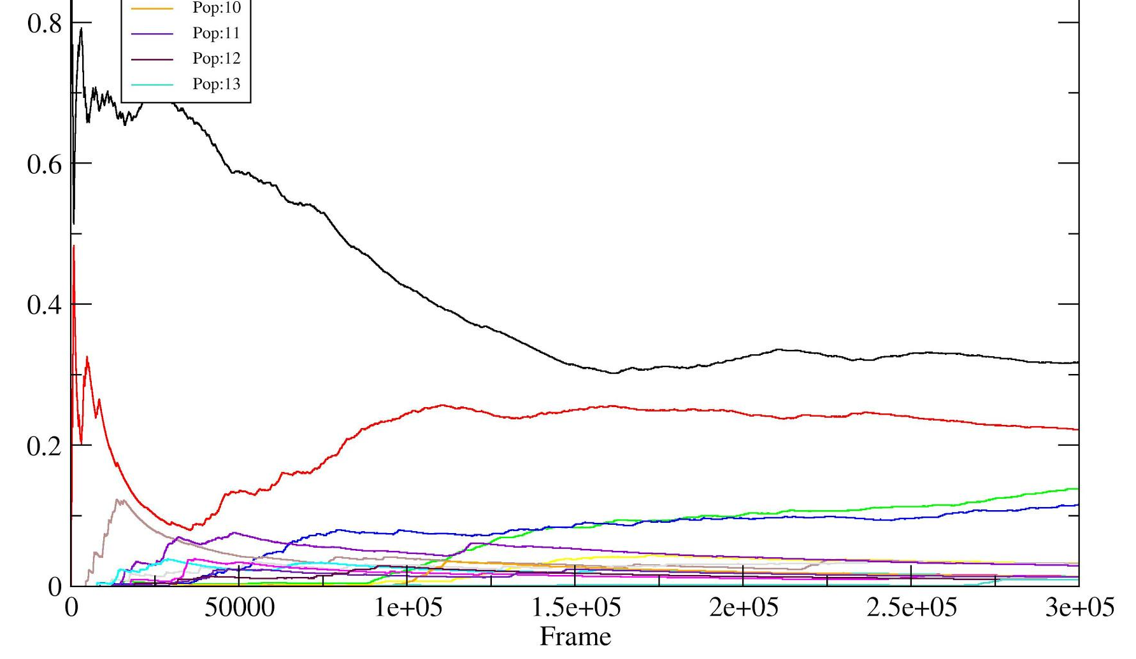
Other issues:
T-REMD still not “fully” converged (depending on def.)
Not only are those four conformations populated,
more like ~20+ populated > 1%
24 replicas, 277-396K
~3 μs / replica

Slide 7
multi-D REMD – Bergonzo / Roe, Roitberg / Swails
Change in “energy representation”
pH
restraints, umbrella potentials, …
force field / parameter sets
biasing potentials (aMD)
Fukunishi, H., Wanatabe, O., and Takada, S., J. Chem. Phys. 2002.
Sugita, Y., Kitao, A., and Y. Okamoto, J. Chem. Phys. 2000.

Slide 8
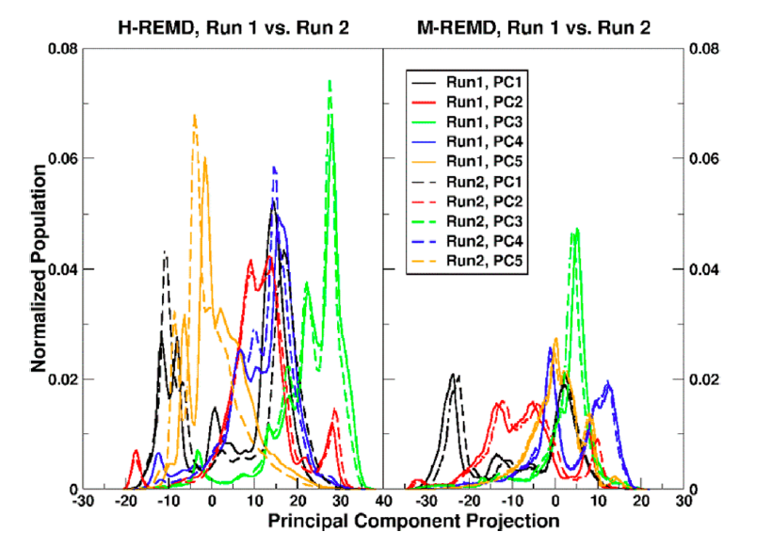

Slide 9
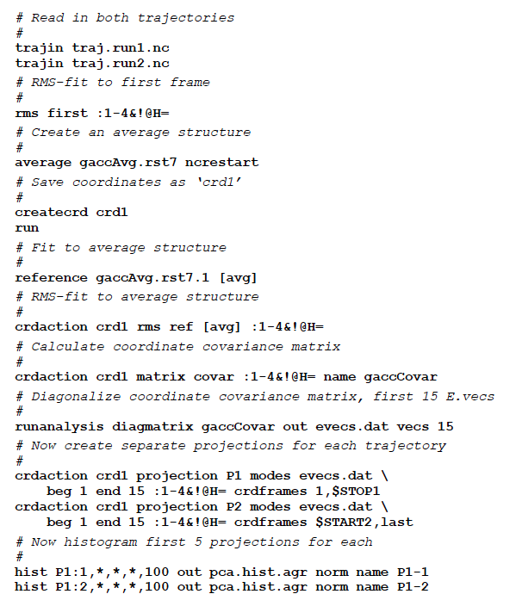
CPPTRAJ
in AmberTools

Slide 11
