Slide 1

Practical Guide to Umbrella Sampling
How to run these simulations using Amber
vs.

Slide 2
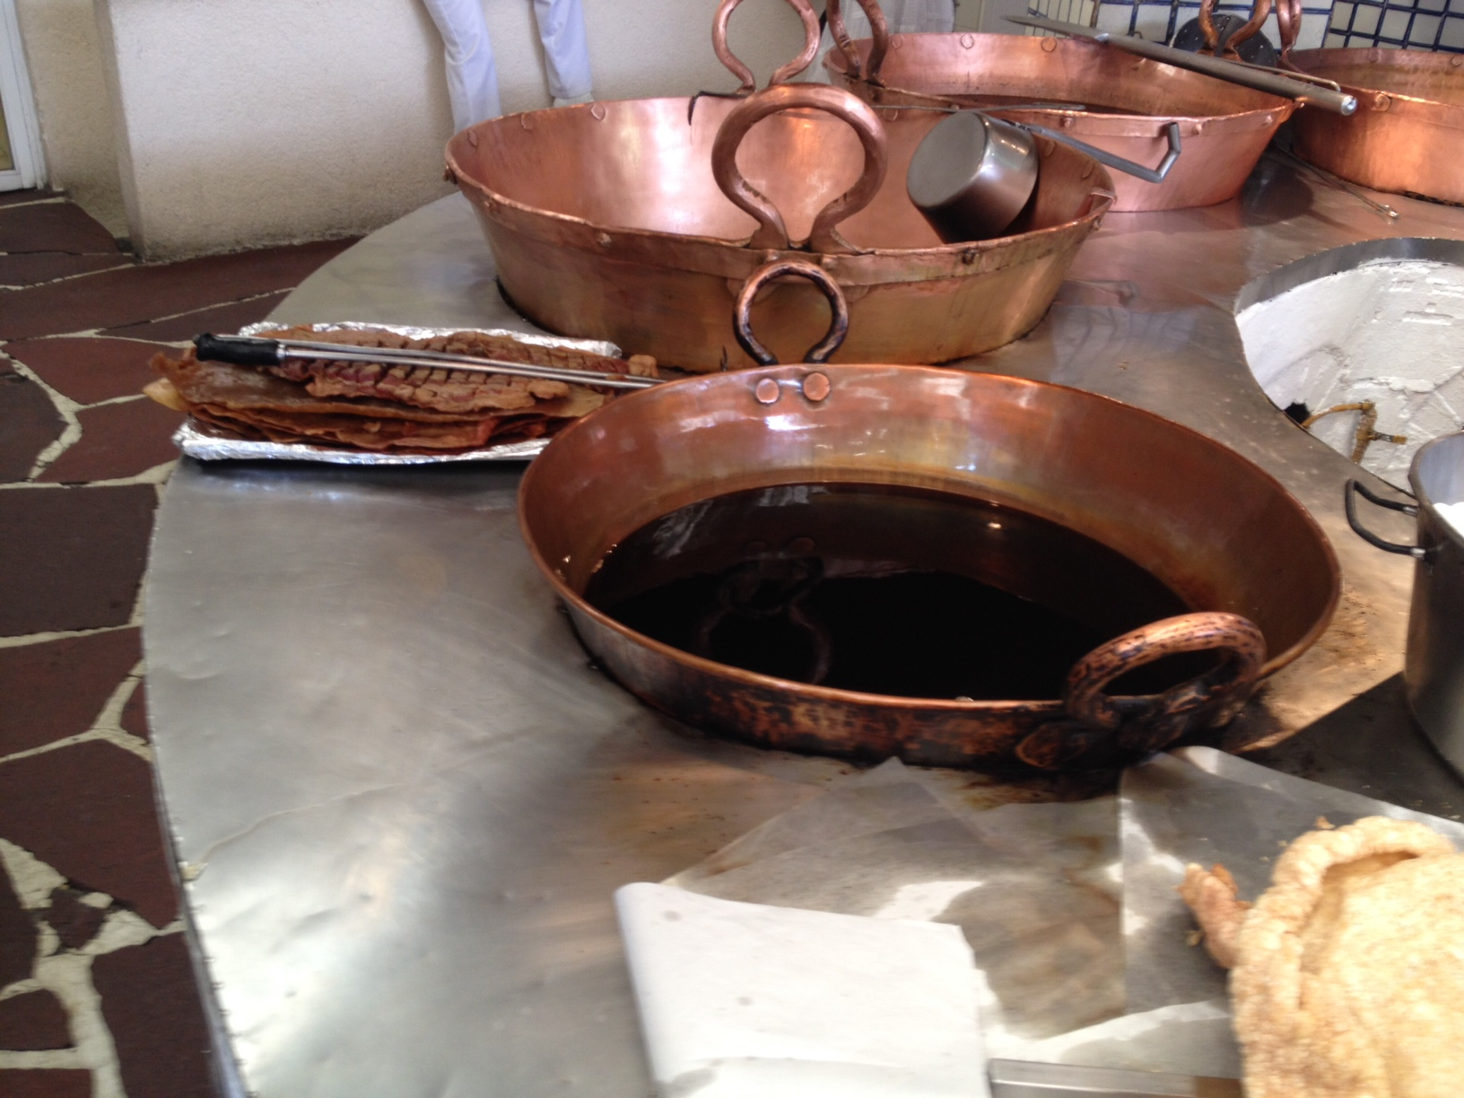

Slide 3
Cazuela sampling?

Slide 4
ΔG
(progress of) reaction coordinate

Slide 5
Add “restraint” to force simulation
to sample barrier region.
But, how can we unbias or
correct for this added restraint?
ΔG
(progress of) reaction coordinate

Slide 6
But, how can we unbias or
correct for this added restraint?
Add multiple “overlapping” umbrellas!!!
ΔG
(progress of) reaction coordinate

Slide 7
Can we estimate the populations???
(( what is a reaction coordinate? ))

Slide 8
Aside: reaction coordinate
E
(or ε)
Examples:
rotation angle
h-bond distance
R_{gyration} (folding)
# native contacts
atom positions
…
“reaction coordinate”

Slide 9
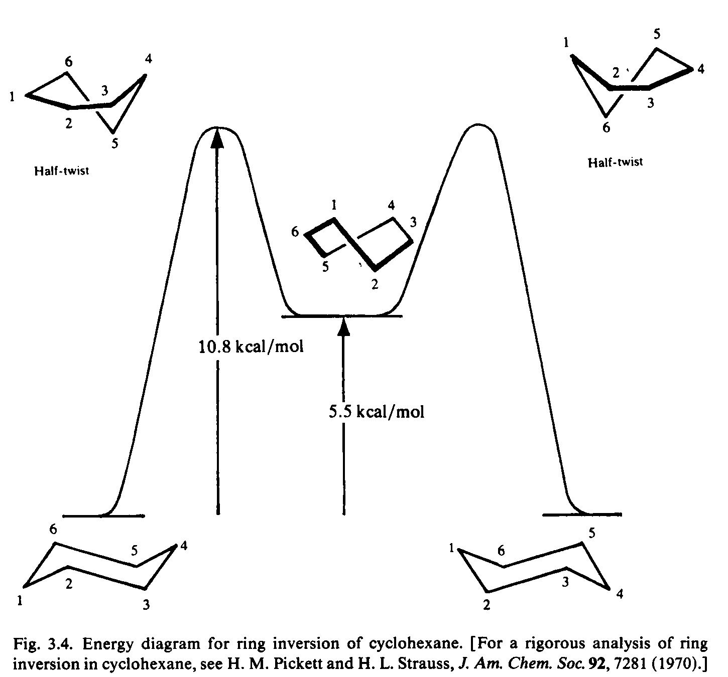
Carey & Sundberg, Advanced Organic Chemistry 3rd edition, Part A: Structure & Mechanisms
~2.0 kcal/mol from bond-angle strain,
~4.4 kcal/mol from van der Waals,
~5.4 kcal/mol from torsional strain

Slide 10
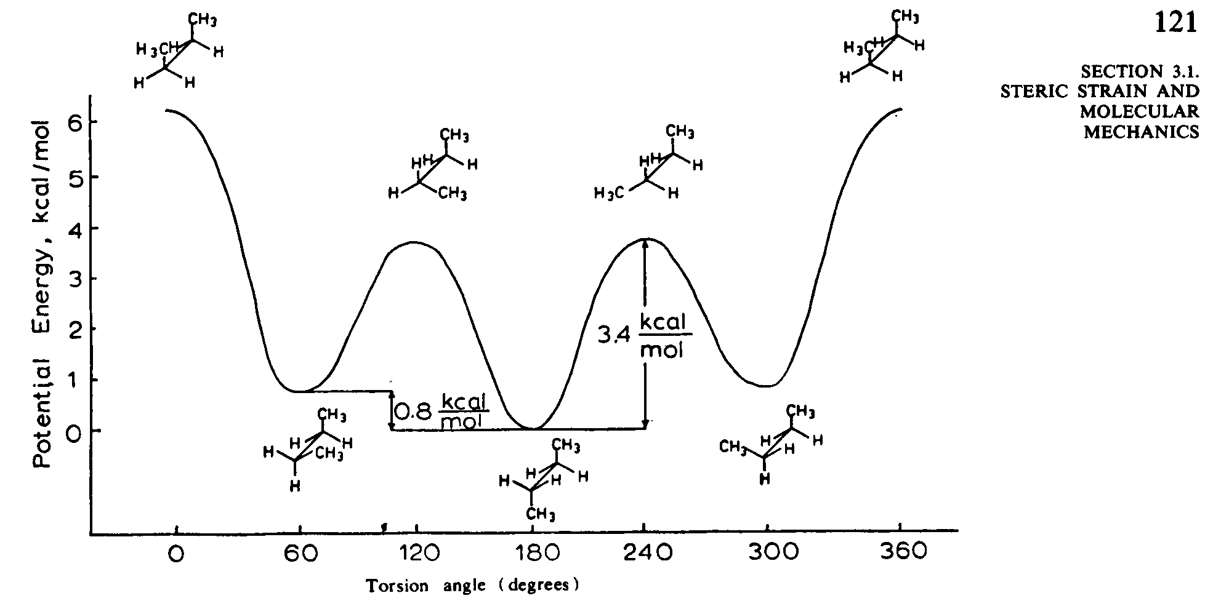
Besides gauche-anomeric effects, can sterics or other intra- or inter-molecular properties alter the barriers to rotation?
Carey & Sundberg, Advanced Organic Chemistry 3rd edition, Part A: Structure & Mechanisms
van der Waals repulsion raises energy slightly
What does a 0.8 kcal/mol difference mean in terms of the populations?

Slide 11
energy of i^{th} state
k: Boltzmann constant
T: temperature
kT ~0.6 kcal/mol at room temp.
exp()
sampling according to the expected probability of observing a given conformation at a given temperature
probability of observing state i
partition function
(sum over states; normalization)

Slide 12
ultimately we want (free) energetics
ΔG = ΔH – TΔS = -RT ln K_{eq}
U(coordinates) ≈ H
Boltzmann equation
snapshot vs. movie vs. ensemble

Slide 13
Potential of Mean Force
(free) energy changes → reaction coordinates
Allows for sampling of statistically-improbable states
PMF: Free energy profile along the reaction coordinate (r).
Reaction Coordinates examples: angle of torsion, distance, RMSD values, etc.
Highly dependent of the system (!!!)

Slide 14
Free energies along a defined reaction coordinate via Umbrella Sampling

Slide 15
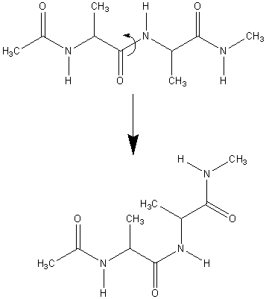
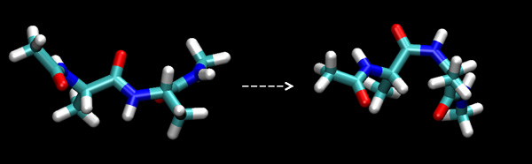
Umbrella Sampling
How to force barrier crossings without compromising thermodynamic properties?
Very slow transitions

Slide 16
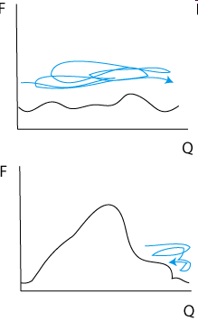
Umbrella Sampling
good for ΔG
trapped, bad ΔG

Slide 17
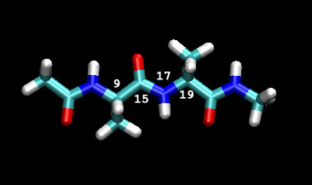
One could just run dynamics and wait until all space has been sampled.
Then, if one extracts P(x_{k}) from the trajectory, the PMF can be written as:
This is called unbiased sampling
However, it takes forever to properly sample all conformations, and to jump over the barrier. The solution is to bias the system towards whatever value of the coordinate we want.

Slide 18
Umbrella Sampling
We could BIAS the simulation, but we do not really know how to do it exactly.
True PMF
Ideal Biasing
Potential
No barrier,
perfect sampling

Slide 19
Umbrella Sampling
Introduce biasing potentials along the reaction coordinate
Windows: 1 2 3 4 5
choose i, k and x_{i} system-dependent
True PMF

Slide 20
Adding a quadratic biasing potential

Slide 21
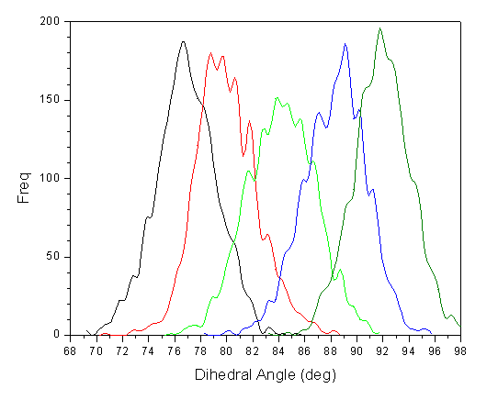
Check for sufficient overlap
Histograms from neighboring windows should overlap strongly, all points on the RC must be sampled suffciently.

Slide 22
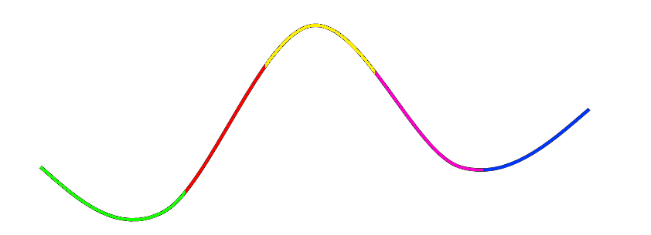
Umbrella Sampling
Constructing the PMF
Solved iteratively using e.g. the WHAM program by Alan Grossfield
Simulation Window Histogram Part of PMF
Final computed PMF from many windows

Slide 23
Umbrella Sampling
Check for sufficient overlap between sampled regions
Solved iteratively using e.g. the WHAM program by Alan Grossfield (http://membrane.urmc.rochester.edu/content/wham)
Histograms from neighboring windows should overlap strongly,
all points on the RC must be sampled suffciently.

Slide 24
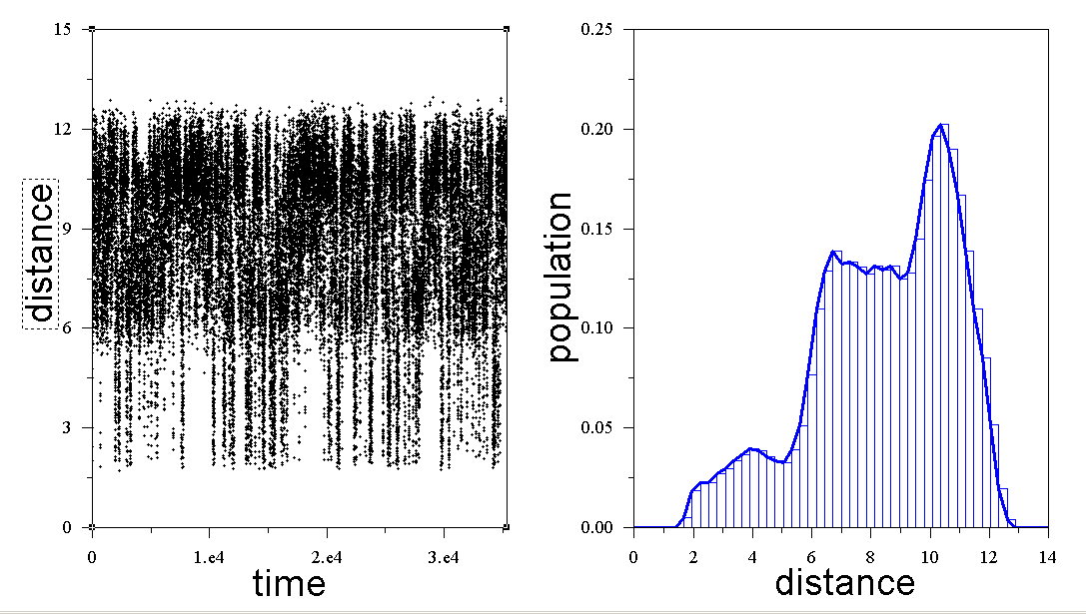
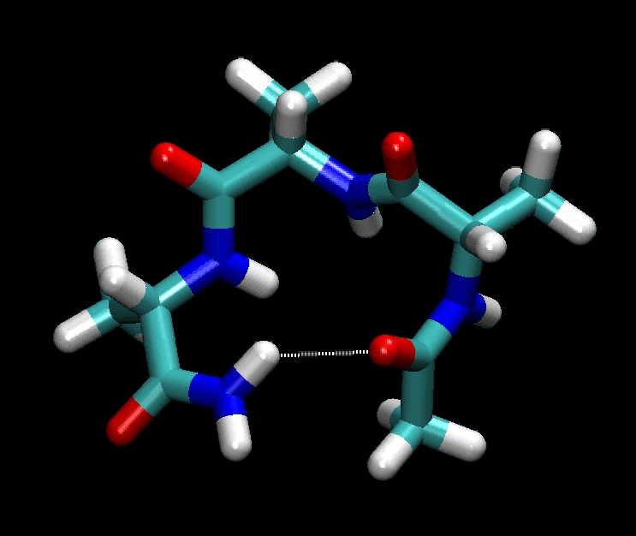
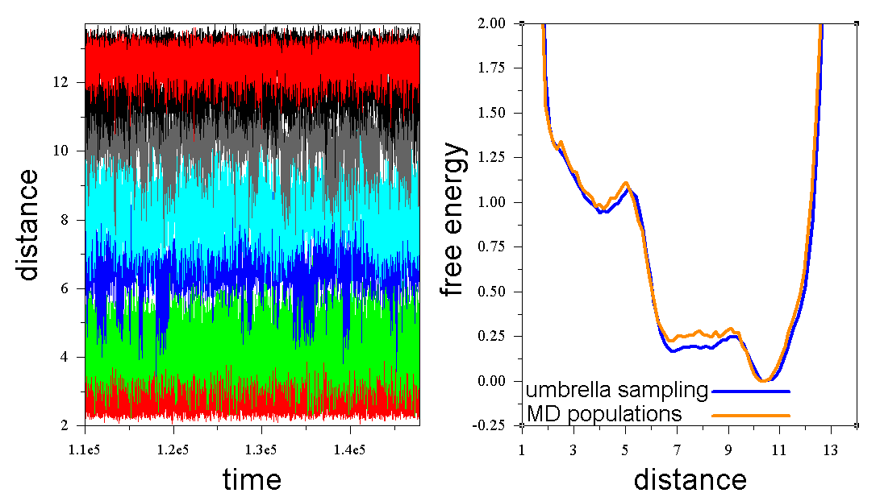
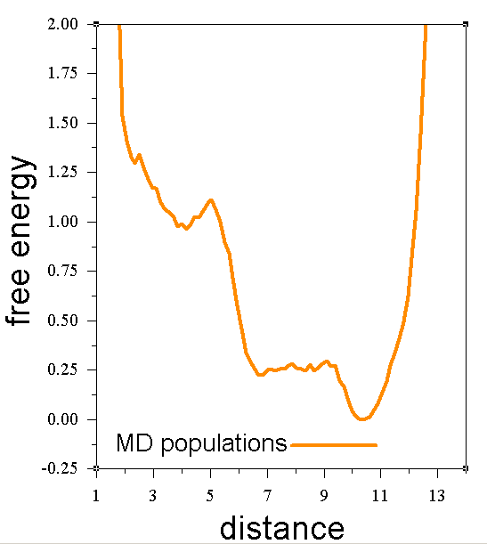
Histograms & free energy profiles
G= -RTlnP/P₀
Umbrella run needs many simulations
Do NOT need to sample full range in 1 simulation

Slide 25
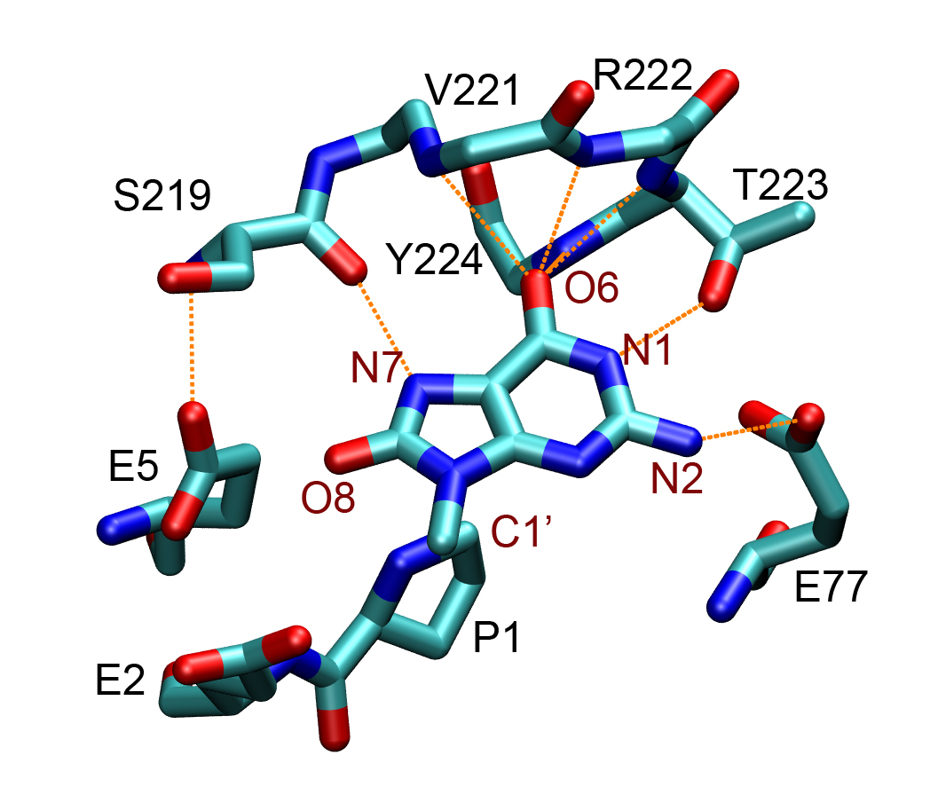
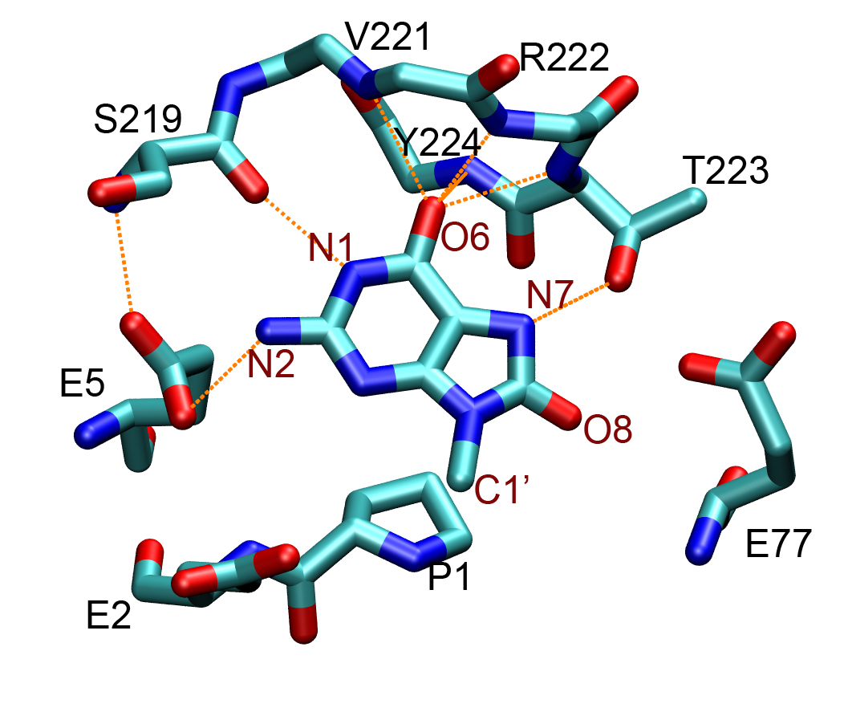
Comparing 2 conformations
It will take much too long to get precise populations for these 2 minima just by running MD.
Song, Hornak, de los Santos, Grollman and Simmerling, Biochemistry 2006

Slide 26
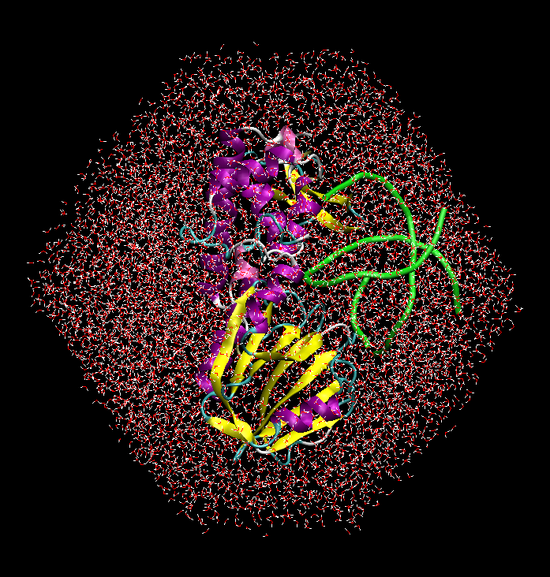
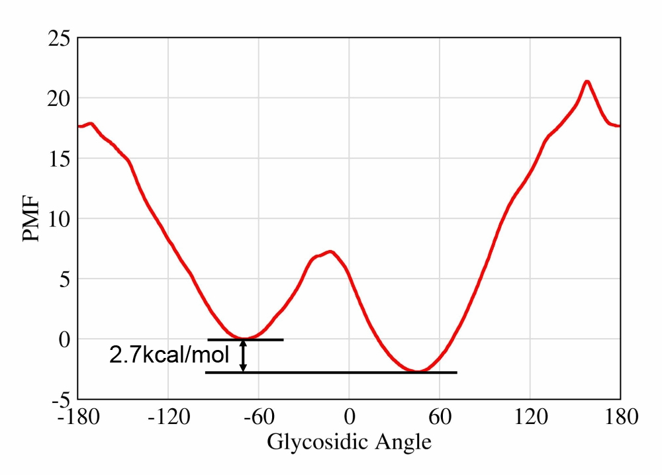
8OG binding mode in complex: dihedral umbrella sampling
anti
syn
Song, Hornak, de los Santos, Grollman and Simmerling, Biochemistry 2006

Slide 27
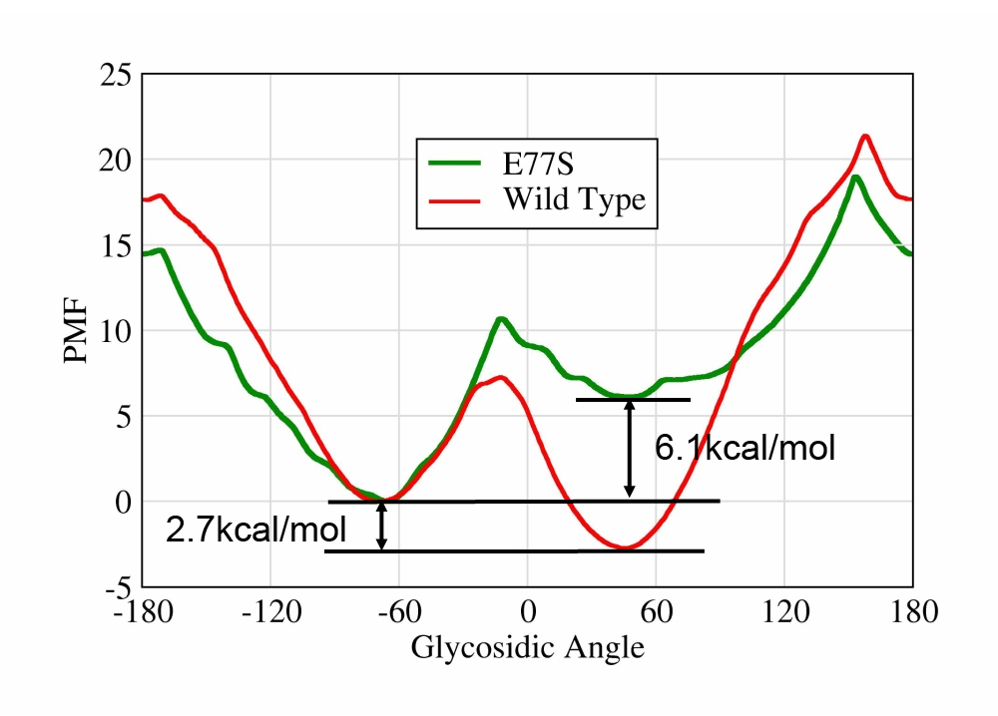
Effect of mutations
syn
anti
Simulations reveal how the energy profile changes if a mutation is made
Song, Hornak, de los Santos, Grollman and Simmerling, Biochemistry 2006

Slide 28
Quick Overview
1 2 3 4 5 6
Windows:
choose i, k and x_{i} system-dependent
True PMF
(progress of) reaction coordinate

Slide 29
What do we need?
Reaction coordinate
distance
angle
dihedral
linear combinations thereof
etc.
Umbrella Restraint
Quadratic function (½ k (x-x₀)²)

Slide 30
What does AMBER 12 provide?
NMR restraint facility (Ch. 6 of Manual)
available in both sander and pmemd
distance restraints
angle restraints
dihedral restraints
generalized distance restraint*
plane-point angle restraint*
plane-plane angle restraint*
*sander ONLY!

Slide 31
Flat-well potential
The NMR restraint is a so-called “flat-well potential” that has 4 parameters; very flexible

Slide 32
Flat-well potential

Slide 33
Flat-well potential

Slide 34
Setting up restraints
Umbrella Sampling input file
&cntrl
ntx=5, irest=1,
ntpr=1000, ntwr=10000,
ntwx=1000, ioutfm=1,
dt=0.002, nstlim=100000,
ntt=3, gamma_ln=5.0,
ntb=0, igb=5,
nmropt=1,
/
&wt
type=‘DUMPFREQ’, istep1=50,
/
&wt type=‘END’ /
DISANG=dist.1.RST
DUMPAVE=dist.1.dat
turn on NMR restraints
We want to dump RC
values with a given
frequency
Frequency with which
to dump RC values
File with restraint definitions
File to dump RC values to

Slide 35
Setting up distance restraints
DISANG=dist.1.RST DUMPAVE=dist.1.dat
&rst
iat=10, 15,
r1=0, r2=5,
r3=5, r4=20,
rk2=50.0, rk3=50.0,
/
0 5.225
50 5.102
100 4.923
150 4.894
200 5.054
250 4.712
300 5.342
350 5.024
400 5.121
450 4.989
This defines a distance restraint
between atoms 10 and 15 that
is parabolic between 0 and 20 Å
centered at 5 with a force constant equal to 50 kcal/mol Å².
NOTE: rk2 and rk3 are NOT
multiplied by ½. The restraint
energy is rk2 (r-r2)²
actual
distance
step

Slide 36
Setting up angle restraints
&rst
iat=10, 15, 20,
r1=0, r2=108,
r3=108, r4=180,
rk2=50.0, rk3=50.0,
/
This defines an angle restraint
between atoms 10, 15, and 20 that is parabolic between 0 and 180º centered at 108º with a force constant equal to 50 kcal/mol rad².
(notice the degrees and radians!)

Slide 37
Setting up dihedral restraints
&rst
iat=10, 15, 20, 25,
r1=0, r2=108,
r3=108, r4=360,
rk2=50.0, rk3=50.0,
/
This defines an angle restraint
between atoms 10, 15, 20, and 25 that is parabolic between 0 and 360º centered at 108º with a force constant equal to 50 kcal/mol rad².
(notice the degrees and radians!)

Slide 38
Setting up restraints
&rst
iat=-1, -1,
igr1=8,9,10,11,12,
igr2=20,21,22,23,
r1=0, r2=5,
r3=5, r4=20,
rk2=50.0, rk3=50.0,
/
You can use up to 4 groups in sander (igr1, igr2, igr3, igr4) and up to 2 groups in pmemd (igr1, igr2)
This defines a distance restraint
between atom groups. When a given atom number is negative, it reads that atom from the given group. This input file defines a distance restraint between the COG of atoms 8, 9, 10, 11, 12 and the COG of atoms 20, 21, 22, 23.
COG = Center of Geometry

Slide 39
More Umbrella Sampling
More advanced options

Slide 40
Generalized Distance Restraints
Suppose the reaction coordinate you want to measure several distances, such as a proton transfer or network of proton transfers
What we do is set up a “generalized” distance restraint which is a linear combination of several different distances
sander only! Supports up to 4 distances.

Slide 41
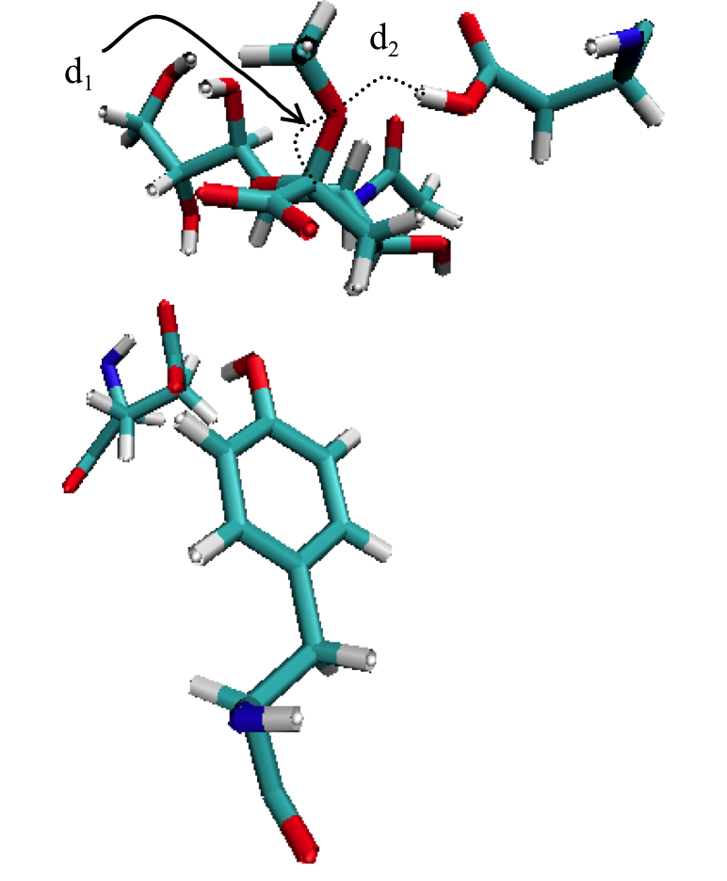
Generalized Distance Restraints
In this example, I want to simulate the PMF for the proton transfer from the carboxylate to the leaving group as the leaving group detaches from the main sugar ring. Thus, we want d₂ to shrink while we want d₁ to grow.

Slide 42
Generalized Distance Restraints
To get the individual distances now (to find the path that it took), you’ll have to histogram the distances explored in the trajectory file.
Energy
Reaction Coordinate

Slide 43
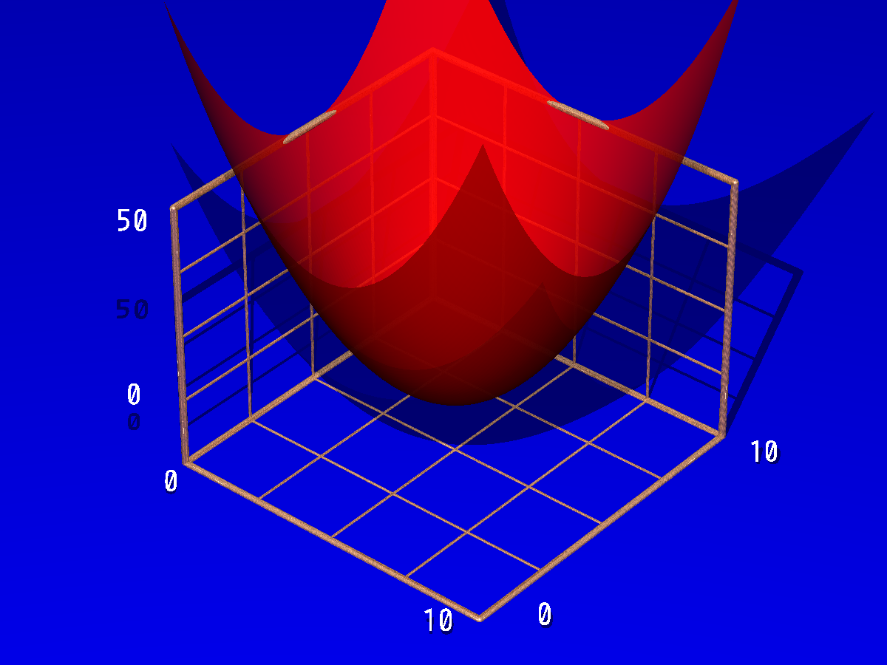
2-D Umbrella Sampling

Slide 44
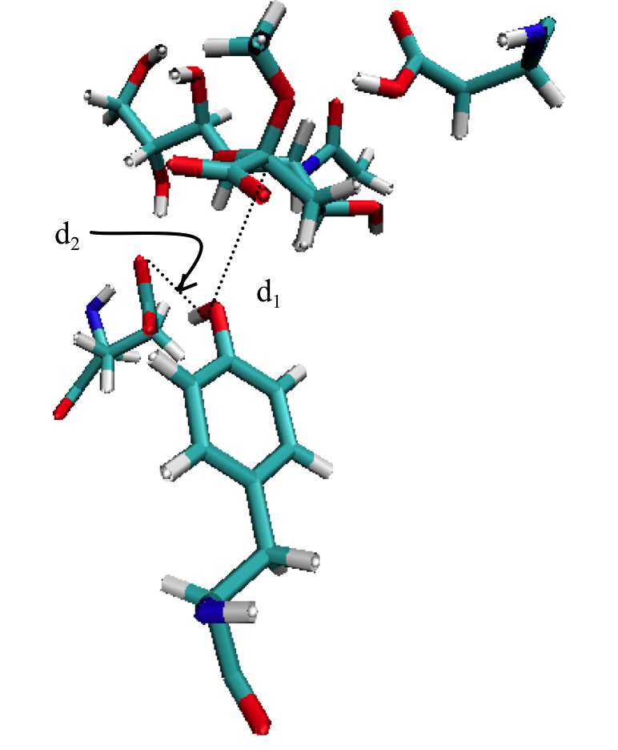
2-D Umbrella Sampling
You now need restraints on 2 different reaction coordinates
dist.1.rst
&rst
iat=5327,5818,
r1=0, r2=1.20, r3=1.20, r4=10.0,
rk2=100.0, rk3=100.0,
/
&rst
iat=5328,3534,
r1=0.0, r2=2.70, r3=2.70, r4=10.0,
rk2=100.0, rk3=100.0,
/

Slide 45
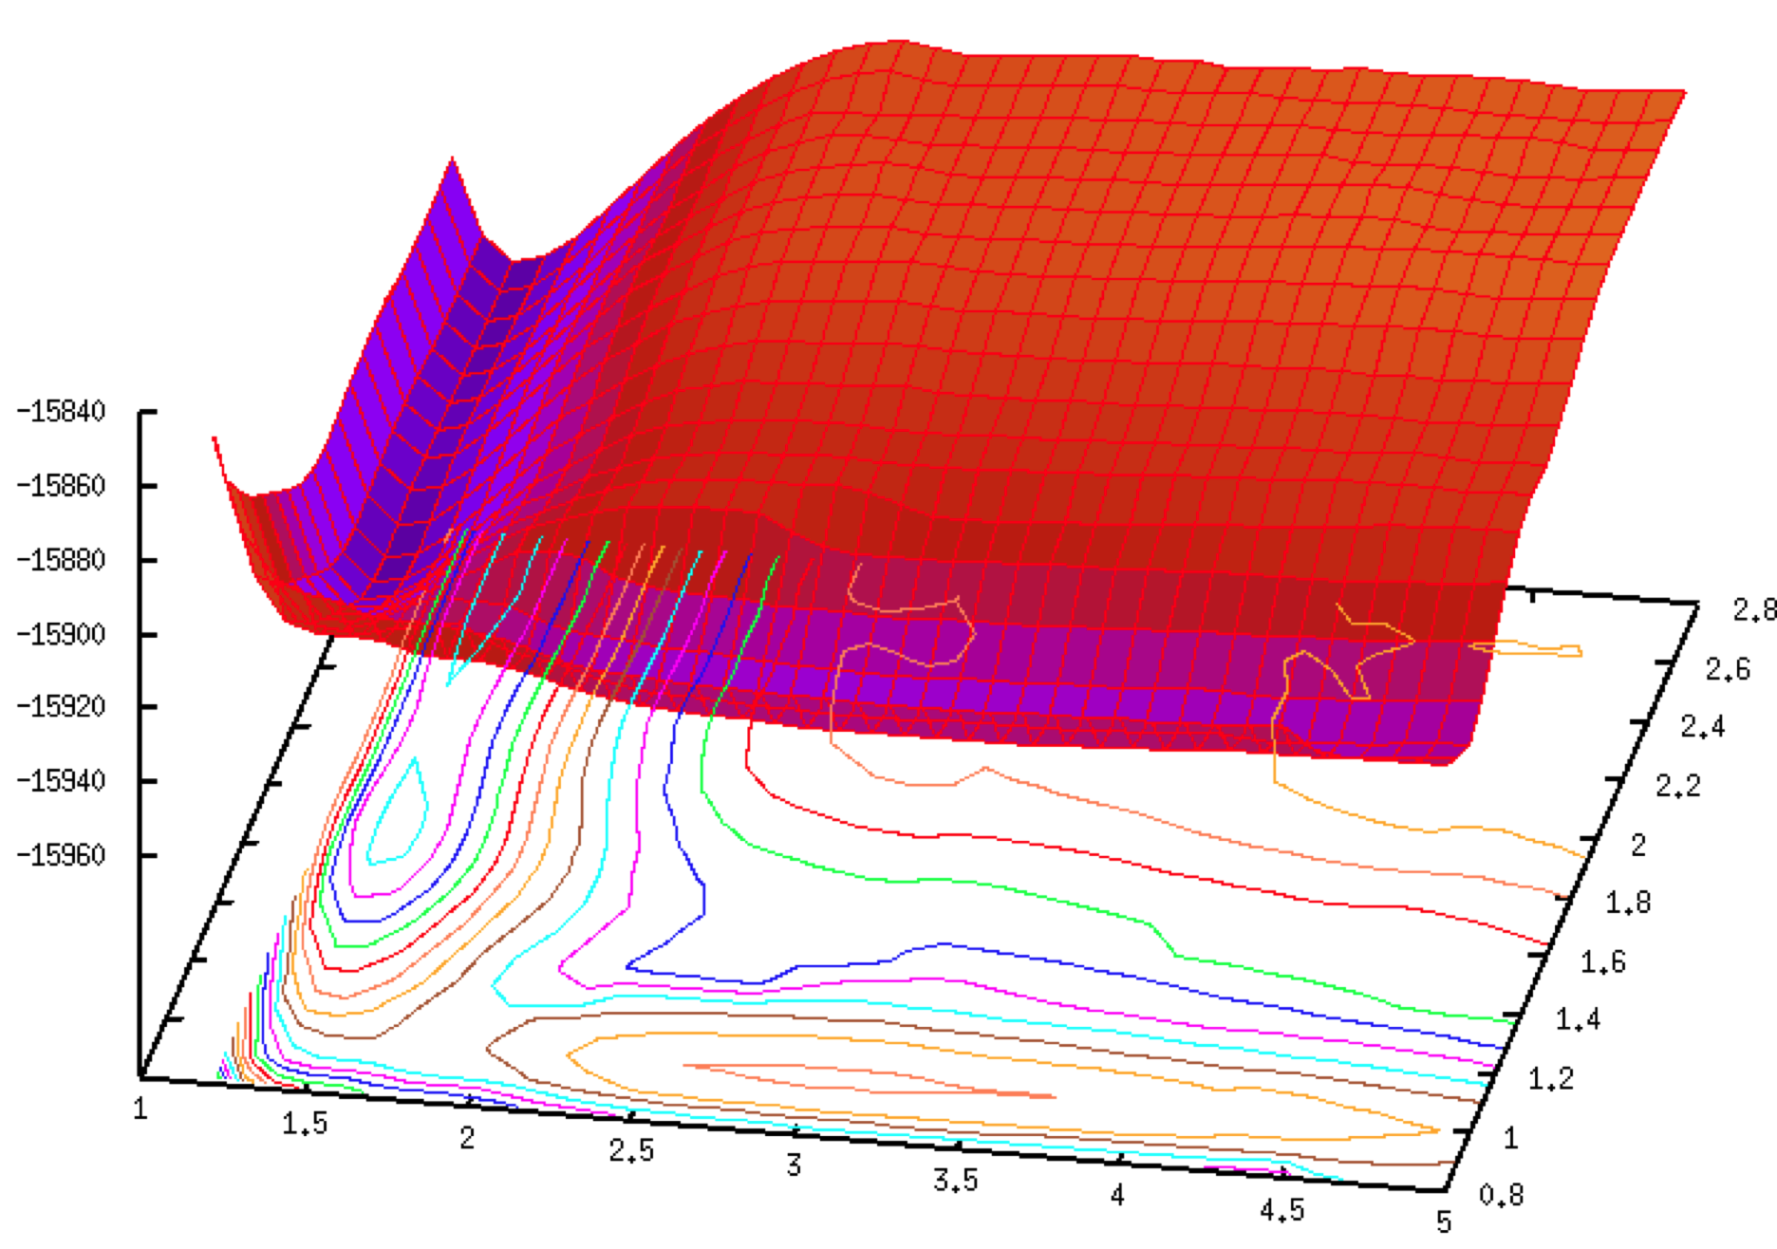
2-D Umbrella Sampling

Slide 46
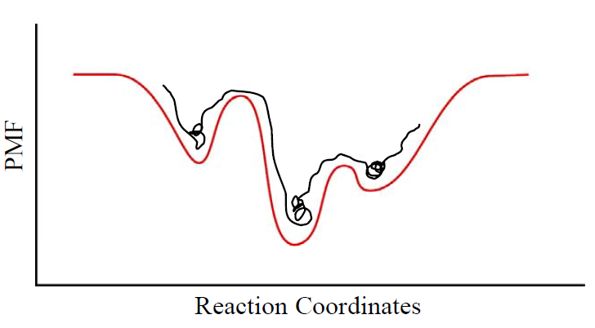
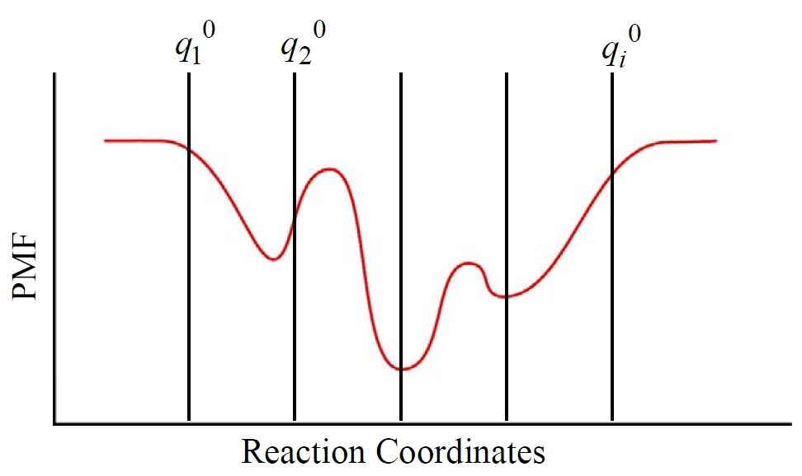

Slide 47
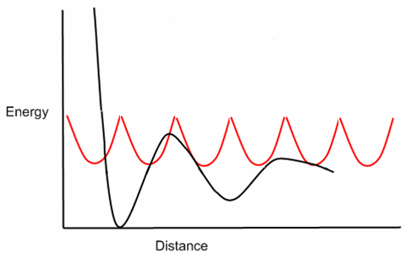
Umbrella sampling - WHAM
Umbrella sampling – overcome the sampling problem
WHAM – recombine the results
$$F\left(r\right)=−kBT ln q\left(x\right)−U\left(x\right)+F′$$

Slide 48
Methods to remove the BIAS from the sampling:
Weighted Histogram Analysis Method
Kumar, et al. J. Comput. Chem., 16:1339-1350, 1995 Benoit Roux. Comput. Phys. Comm., 91:275-282, 1995
mBar
Shirts and Chodera. J Chem Phys. 129(12): 1, 2008

Slide 49
Dr. Grossfield WHAM implementation
Fast, simple.
Compatible with AMBER nmropt=1 keyword
1D and 2D WHAM
http://membrane.urmc.rochester.edu/content/wham
Example of 2D-restraint:
&rst
iat=31,158,
r1=0, r2=18.56, r3=18.56, r4=100,
rk2=1.0, rk3=1.0,
&end
&rst
iat=63,126,
r1=0, r2=19.25, r3=19.25, r4=100,
rk2=1.0, rk3=1.0,
&end

Slide 50
Example of input file
Input file for production run using distance restraints
&cntrl
imin=0, ntx=7, ntpr=500, ntwr=500, ntwx=500, ntwe=500,
nscm=5000,
ntf=2, ntc=2,
ntb=2, ntp=1, tautp=5.0, taup=5.0,
nstlim=100000, t=0.0, dt=0.002, cut=9.0,ntt=1,
irest=1,
iwrap=1,
ioutfm=1,
nmropt=1,
&end
&ewald
ew_type = 0, skinnb = 1.0,
&end
&wt type='DUMPFREQ', istep1=100 /
&wt type='END' /
DISANG=~/sampling/3mer/restraint_PO4/inputs/aa.dat
DUMPAVE=aa.dat.1

Slide 51
Example of output file from AMBER
0 18.108 18.185
100 17.768 18.393
200 17.436 17.753
300 17.271 17.887
400 17.196 17.542
500 17.135 17.584
600 17.166 17.522
700 17.062 17.745
800 16.938 17.859
900 17.277 17.985
1000 17.111 17.864
1100 16.958 17.907
1200 17.150 18.134
1300 17.513 17.808
1400 17.331 17.773
1500 16.677 17.888
1600 16.596 17.761
1700 16.882 17.630
1800 17.022 17.787
1900 17.379 17.681

Slide 52
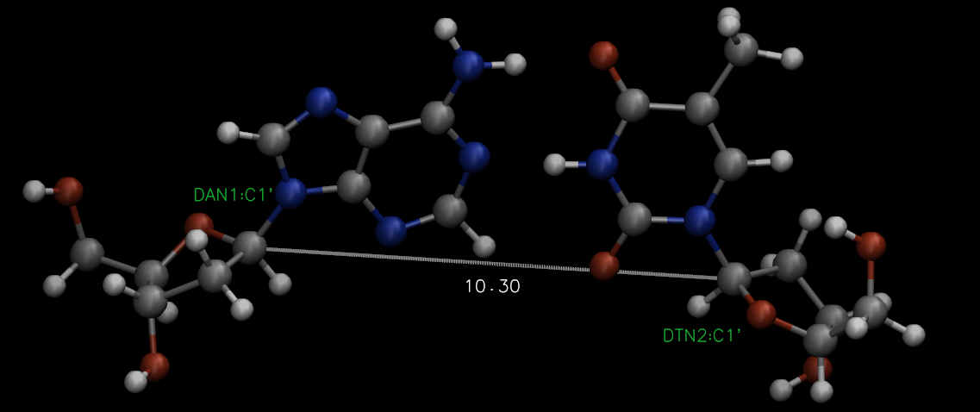
Example
DNA 1-mer (AT)
Reaction coordinate: distance (from 9 to 20 Å)
Restrains in C1’

Slide 53
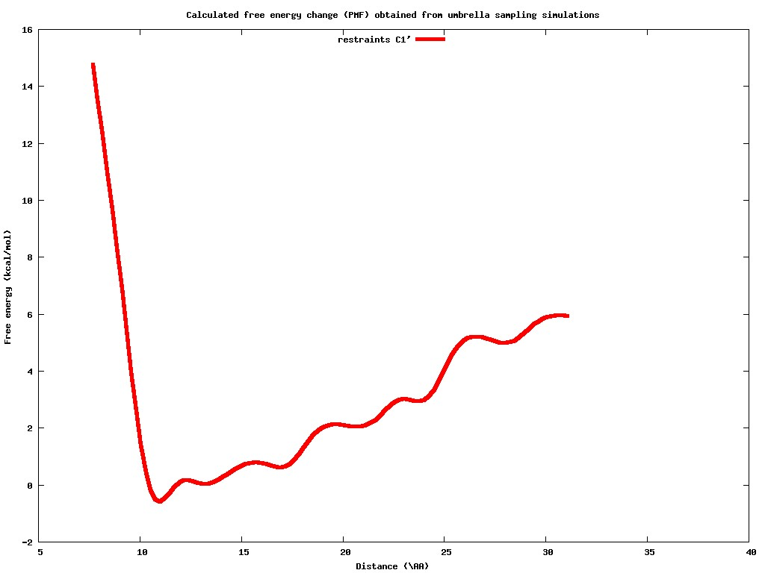
1mer AT

Slide 54
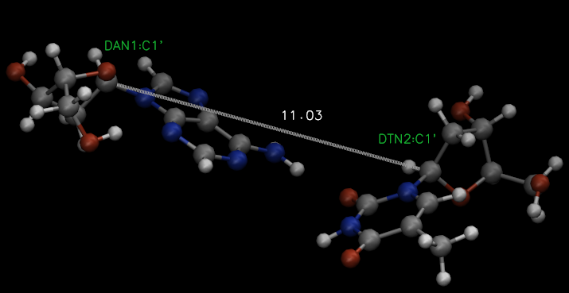
1mer AT

Slide 55
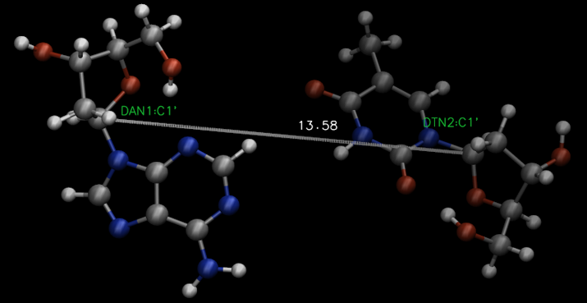
1mer AT

Slide 56
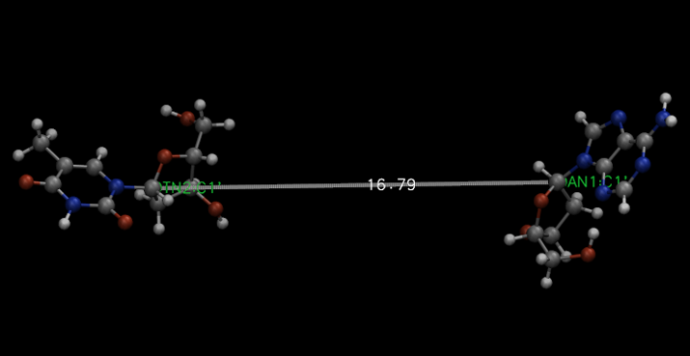
1mer AT

